Slide 1
Accelerating Systems with Programmable Logic Components Lecture 09 Verification II Basic concepts and methods of Verification
1DT109 ASPLOC
2021 VT1-VT2
Yuan Yao, yuan.yao@it.uu.se

Slide 2
Verification technologies
Linting
Randomization
Assertion
Delta delay
Functional coverage

Slide 3
Linting
“Lint” comes from the name of a UNIX utility that parses C program and reports questionable uses and problems.
A static checking technology requiring no stimulus
Fast but can report false negatives
int my_func (addr_ptr, ratio){
int *addr_ptr;
float ratio;
return (*addr_ptr)++;
}
Argument “ratio” unused
addr_ptr may be used before being set
Arg. 1 used inconsistently
my_func returns value which is always ignored
Lint
main () {
int my_addr;
my_func (my_addr);
}

Slide 4
Linting
Getting the best out of Linting
Carefully filter error and warning messages in Vivado
Naming conventions can help output filtering
Do not turn off checks/issue reporting
Link code as it is written
Enforce coding guidelines
Linting was not integrated into IDE as it is nowadays.
However, Linting tool was available such as NLint.
always_ff @ (a, b)
if (b)
c <= a;
always_comb
if (b)
c <= a;

Slide 5
Randomization – $random, $urandom
Randomization ≠ aimless
Good aim = clear context to exert potential bugs
Randomization use $random, $urandom
Both returns 32-bit random number
$random returns signed number (-2³¹ to 2³¹-1)
$urandom returns unsigned number (0 to 2³²-1)
You can control the range of randomization using
variable = $urandom_range( int unsigned maxval, int unsigned minval = 0 );
a = $urandom_range(30,20);
b = $urandom_range(20);
There is no $random_range
Hard to use within context and OOP.
Take “0” as min
How to generate negative using urandom_range?

Slide 6
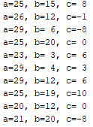
Randomization – $random, $urandom
module demo_8;
initial begin
repeat (10)
$display("a=%2d, b=%2d, c=%2d",
$urandom_range(30, 20),
$urandom_range(20),
$signed($urandom_range(30, 10))-20);
end
endmodule
Must convert to signed integer here!

Slide 7
Randomization – rand/randc
Variables declared with the rand/randc keyword are standard random variables. Their values are uniformly distributed over their range.
rand bit [3:0] addr; // Uniformly distributed among [4’b0000, 4’b1111]
randc bit [3:0] addr; // Uniformly distributed among [4’b0000, 4’b1111] addr doesn’t repeat until every possible value has been assigned.
Can be used together with constraints, which controls the range of a rand variable.
Can be used in randomized class object
Easy to use within verification context.

Slide 8
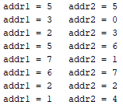
Randomization – rand/randc
class packet;
rand bit [2:0] addr1;
randc bit [2:0] addr2;
endclass
module demo_9;
initial begin
packet pkt;
pkt = new();
repeat (8) begin
pkt.randomize();
$display(“ addr1 = %0d \t addr2 = %0d ",
pkt.addr1,
pkt.addr2);
end
end
endmodule
Refresh the value of addr1 and addr2 each time calling the randomize() function
No repeated value.
Twice of value “2” and “5”

Slide 9

Randomization – rand/randc in Class
typedef enum {STACK=1, HEAP=2, WHOLE=3} region;
class random_memory_loader;
region mtype;
rand bit [63:0] addr;
rand logic [7:0] data;
constraint addr_con {
mtype == STACK -> {
addr >= 64'h8000_0000_0000_0000;
addr <= 64'hffff_ffff_ffff_ffff;
}
mtype == HEAP -> {
addr >= 64'h0000_0000_0000_0000;
addr < 64'h8000_0000_0000_0000;
}
mtype == WHOLE -> {
addr >= 64'h0000_0000_0000_0000;
addr <= 64'hffff_ffff_ffff_ffff;
}
}
endclass: random_memory_loader
module demo_10;
sparse_memory mem = new();
random_memory_loader loader = new();
initial begin
region mtype = mtype.first();
for (int i = 1; i <= mtype.num(); i++) begin
loader.mtype = mtype;
repeat (10) begin
loader.randomize();
mem.write(loader.addr, loader.data);
loader.display();
end
mem.display();
mtype = mtype.next();
end
end
endmodule

Slide 10
Assertion
Assertions are primarily used to validate the behavior of a design.
Assertions can be checked dynamically by simulation
Or statically by a separate property checker tool.
Such as formal verification tool (next lecture)
There are two kinds of assertions in SystemVerilog
Immediate assertion (assert)
Check the design’s immediate behavior
Concurrent assertion (assert property)
Check the design’s temporal behavior

Slide 11

Immediate assertions
An immediate assertion is a statement that something in the design must be true.
Conceptually like an if-statement
Difference with if-statement: immediate assertion can issue $fatal, $error, $warning when failed.
If the conditional expression of the immediate assert evaluates to X, Z or 0, then the assertion fails, and the simulator writes an error message.
module demo_11;
bit [3:0] A = 4'b0000;
bit [3:0] B = 4'b0000;
logic [3:0] C = 4'b000x;
initial begin
if (A == B)
$display("A == B");
else
$display("A != B");
assert (A == C);
end

Slide 12
Example – Immediate assertions
All the following immediate assertions are valid.
assert (A == C)
$display ("OK. A equals C");
else
$warning ("It's gone wrong");
An immediate assertion with both a pass statement and a failure statement.
$warning -> does not terminate simulation, can be suppressed.
An immediate assertion with a failure statement only.
$error -> does not terminate simulation, cannot be suppressed.
assert ((A == B) && (A == C))
else
$error ("It's gone wrong");
assert (A == C)
$display ("OK. A equals C");
else
$fatal ("It's gone wrong");
An immediate assertion with a failure statement only.
$fatal -> terminates simulation when fails.

Slide 13
Concurrent assertions
Concurrent assertions are used to check temporal behavior of a logic.
To use concurrent assertions:
Setup the property of the logic that you want to monitor/check via the property structure
Define behaviors of interests (either immediate or temporal) within the property structure
Monitor the behaviors of interests via the assert keyword

Slide 14
Example – Concurrent assertions
Step 1 – Setup the property of the logic that you want to monitor/check via the property structure.
At each rising clk edge
Output q pulled down to 1’b0 if rst is 1’b0.
Otherwise, output q follows the value of input d.
The new value can only be observed after the rising clock edge passes.
module dff ( input wire d,
input wire rst,
input wire clk,
output reg q);
always_ff @ (posedge clk)
if (!rst)
q <= 1’b0;
else
q <= d;
endmodule
What properties does this piece of logic have?

Slide 15
Example – Concurrent assertions
always_ff @ (posedge clk)
if (!rst)
q <= 1’b0;
else
q <= d;
property p_1a;
@ (posedge clk)
!rst |=> q == 1’b0;
endproperty
// demo_12
Implication
s1 |-> s2
If s1 is false, the implication returns true without evaluating s2.
If s1 is true, the implication evaluates s2 immediately.
If s2 is true, the implication returns true. Otherwise, false.
s1 |=> s2
When s1 is true, the implication evaluates s2 in the next clock cycle.
At each rising clk edge
Output q pulled down to 1’b0 if rst is 1’b0.
Otherwise, output q follows the value of input d.
The new value can only be observed after the rising clock edge passes.
property p_1b_v1;
@ (posedge clk)
d |=> q;
endproperty
// demo_12
property p_1b_v2;
@ (posedge clk)
d |-> ##1 q;
endproperty
// demo_12

Slide 16
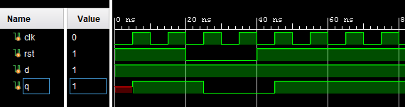
Example – Implication evaluation
always_ff @ (posedge clk)
if (!rst)
q <= 1’b0;
else
q <= d;
s1 |-> s2:
s1
s2
property p_1a;
@ (posedge clk)
!rst |=> q == 1’b0;
endproperty
rst == 1’b1,
!rst is false
q == 1’b0 does not get evaluated, return true.
s1 |=> s2:
s1
s2
s1 |-> ## 1 s2:
s1
s2

Slide 17
Example – Implication evaluation
always_ff @ (posedge clk)
if (!rst)
q <= 1’b0;
else
q <= d;
s1 |-> s2:
s1
s2
property p_1a;
@ (posedge clk)
!rst |=> q == 1’b0;
endproperty
rst == 1’b0,
!rst is true
q==1’b0 is evaluated.
Property holds.
(q has value 1’b0)
s1 |=> s2:
s1
s2
s1 |-> ## 1 s2:
s1
s2

Slide 18
Example – Implication evaluation
always_ff @ (posedge clk)
if (!rst)
q <= 1’b0;
else
q <= d;
property p_1a_f;
@ (posedge clk)
!rst |-> q == 1’b0;
endproperty
rst == 1’b0,
!rst is true
q==1’b0 is evaluated.
Property fails.
(q has value 1’b1)
s1 |-> s2:
s1
s2
s1 |=> s2:
s1
s2
s1 |-> ## 1 s2:
s1
s2

Slide 19

Example – Implication evaluation
Disable the property when reset is on!
always_ff @ (posedge clk)
if (!rst)
q <= 1’b0;
else
q <= d;
property p_1b_v1;
@ (posedge clk)
d |=> q;
endproperty
Are we safe?
No!
When rst is 1’b0, output q does not follow input d
property p_1b_v2;
@ (posedge clk)
d |-> ##1 q;
endproperty

Slide 20
Example – Implication evaluation
always_ff @ (posedge clk)
if (!rst)
q <= 1’b0;
else
q <= d;
property p_1b_v1;
@ (posedge clk) disable iff (!rst)
d |=> q;
endproperty
Are we safe?
Yes!
Disable the property if-and-only-if when rst is 1’b0.
property p_1b_v2;
@ (posedge clk) disable iff (!rst)
d |-> ##1 q;
endproperty

Slide 21
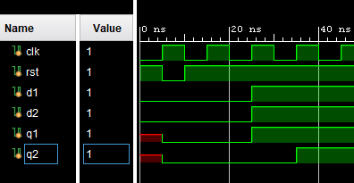
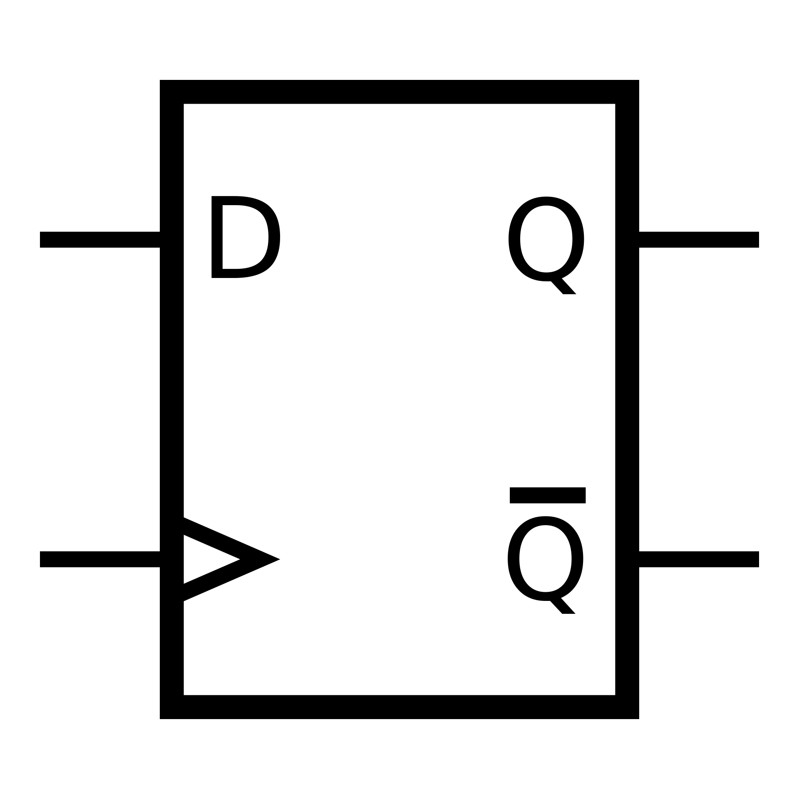
Example – Implication evaluation
initial begin //demo_13
d = 1'b1;
end
initial begin //demo_13
d <= 1'b1;
end
Blocking and non-blocking assignments happen at different instances across clock edge in a seq logic.
clk
clk
always_ff @ (posedge clk)
if (!rst)
q <= 1’b0;
else
q <= d;
D
D
D
D
Q
Q

Slide 22
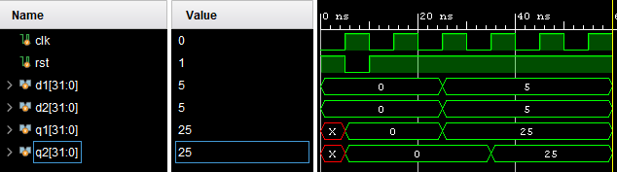
Example – Implication evaluation
initial begin //demo_14
d = 5;
end
initial begin //demo_14
d <= 5;
end
Combi logic happens immediately.
always_ff @ (posedge clk)
if (!rst)
q <= 0;
else
q <= d*d;

Slide 23
Delta delay
Verilog/SystemVerilog simulator is event-based.
Way faster than time-based simulation. Especially efficient in simulating large scale design.
The simulator does not increment time by a basic time unit, timestep or time increment.
Regardless of the simulation resolution, the simulation advances time as far as necessary, in a single step, to the next point in time where there is useful work to do.
Singal change is the driving force.
Time advances
w.r.t. resolution
Same time
Different delta
Head
Tail
evaluate
Event queue
Simulation time increase

Slide 24
Example – Delta delay
Time | Delta | Event
IN: 1
A: 0
C: 0
B: 1
1

Slide 25
Example – Delta delay
Time | Delta | Event
0 ns | 1 | IN: 1 → 0 eval: INVERTER
IN: 1→0
A: 0
C: 0
B: 1
1

Slide 26
Example – Delta delay
Time | Delta | Event
0 ns | 1 | IN: 1 → 0 eval: INVERTER
 | 2 | A: 0 → 1 eval: NAND, AND
IN: 1→0
A: 0→1
C: 0
B: 1
1

Slide 27
Example – Delta delay
Time | Delta | Event
0 ns | 1 | IN: 1 → 0 eval: INVERTER
 | 2 | A: 0 → 1 eval: NAND, AND
 | 3 | B: 1 → 0
IN: 1→0
A: 0→1
C: 0
B: 1→0
1
What is the value of C when the simulator evaluate the AND gate?

Slide 28
Example – Delta delay
Time | Delta | Event
0 ns | 1 | IN: 1 → 0 eval: INVERTER
 | 2 | A: 0 → 1 eval: NAND, AND
 | 3 | B: 1 → 0 C: 0 → 1 (A:1, B:1) (use the old value of B) eval: AND
IN: 1→0
A: 0→1
C: 0→1
B: 1→0
1
always @ (IN)
A = ~IN;
always @ (A, B)
C = A & B;
always @ (A)
B = A ~& 1’b1;
Enable parallel always blocks!
The second block is evaluated twice!
Why is that?

Slide 29
Example – Delta delay
Time | Delta | Event
0 ns | 1 | IN: 1 → 0 eval: INVERTER
 | 2 | A: 0 → 1 eval: NAND, AND
 | 3 | B: 1 → 0 C: 0 → 1 (A:1, B:1) (use the old value of B) eval: AND
 | 4 | C: 1 → 0 (A:1, B:0) (use the new value of B)
IN: 1→0
A: 0→1
C: 0→1→0
B: 1→0
1
always @ (IN)
A = ~IN;
always @ (A, B)
C = A & B;
always @ (A)
B = A ~& 1’b1;
Enable parallel always blocks!
The second block is evaluated twice!

Slide 30
Functional coverage
Functional coverage is a measure of what functionalities or features of the design have been exercised by the test.
This can work together with constrained random verification (CRV) to evaluate how well/thorough the design has been tested.
N.B. Function coverage can not help detecting unimplemented or omitted features in the design.
It can only help testing what has been implemented.

Slide 31
Functional coverage
Functional coverage samples variables of interest in the testbench and analyze if they have reached certain sets of values.
Variables of interest are mentioned as a coverpoint.
Coverpoints are put together in a covergroup block.
Bins are to be “hit/covered” when the variable reaches the corresponding values or value ranges.
If data is randomized as 0, then bin “data_low_end” is hit 1 time.
If data is randomized between [0:127], then bin data_low is hit 1 time.
class random_memory_loader;
region mtype;
rand bit [63:0] addr;
rand logic [7:0] data;
/****************************/
function new();
cov_grp = new();
endfunction: new
/****************************/
covergroup cov_grp;
coverpoint data {
bins data_low_end = {0};
bins data_high_end = {255};
bins data_low = {[0 : 127]};
bins data_high = {[128 : 255]};
}
coverpoint mtype {
bins mtype_bin [] = {[mtype.first : mtype.last]};
}
endgroup
endclass: random_memory_loader
Covergroup need to be initialized before use.

Slide 32
Example – Functional coverage
class random_memory_loader;
region mtype;
rand bit [63:0] addr;
rand logic [7:0] data;
/****************************/
function new();
cov_grp = new();
endfunction: new
/****************************/
covergroup cov_grp;
coverpoint data {
bins data_low_end = {0};
bins data_high_end = {255};
bins data_low = {[0 : 127]};
bins data_high = {[128 : 255]};
}
coverpoint mtype {
bins mtype_bin [] = {[mtype.first : mtype.last]};
}
endgroup
endclass: random_memory_loader
module demo_10;
sparse_memory mem = new();
random_memory_loader loader = new();
initial begin
region mtype = mtype.first();
for (int i = 1; i <= mtype.num(); i++) begin
loader.mtype = mtype;
repeat(10) begin
loader.randomize();
loader.cov_grp.sample();
mem.write(loader.addr, loader.data);
loader.display();
end
mem.display();
mtype = mtype.next();
end
end
endmodule
Use of covergroup is easy.
Each time when a random object is randomized, call the sample() function of a covergroup to do variable statistics.

Slide 33
Example – Functional coverage
After simulation is done, Vivado can report statistics for the declared covergroup in html table format.
All the statistics will be saved in the folder “xsim.covdb” under the simulation repository “verification_1_demo.sim”.
To generate the html table, you need to use the “xcrg” command in the TCL command line to interpret the statistics.
xcrg -report_format html -dir E:/VivadoProject/ASPLOC/verification_1_demo/verification_1_demo.sim/sim_1/behav/xsim/xsim.covdb/
The generated html table is called “dashboard.html”, which is by default created in “..\AppData\Roaming\Xilinx\Vivado\xcrg_report” in Win10.

Slide 34
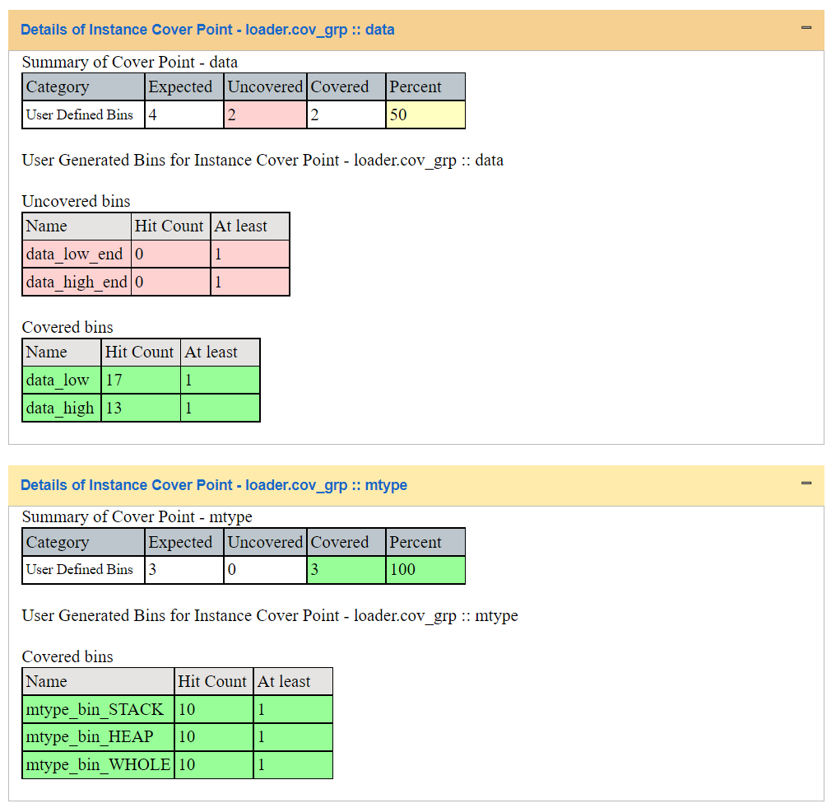
Example – Functional coverage
covergroup cov_grp;
coverpoint data {
bins data_low_end = {0};
bins data_high_end = {255};
bins data_low = {[0 : 127]};
bins data_high = {[128 : 255]};
}
coverpoint mtype {
bins mtype_bin [] = {[mtype.first : mtype.last]};
}
endgroup
None hits here
30 samples
repeat(10) begin
loader.randomize();
loader.cov_grp.sample();
mem.write(loader.addr, loader.data);
loader.display();
end
Evenly hits.
30 samples

Slide 35
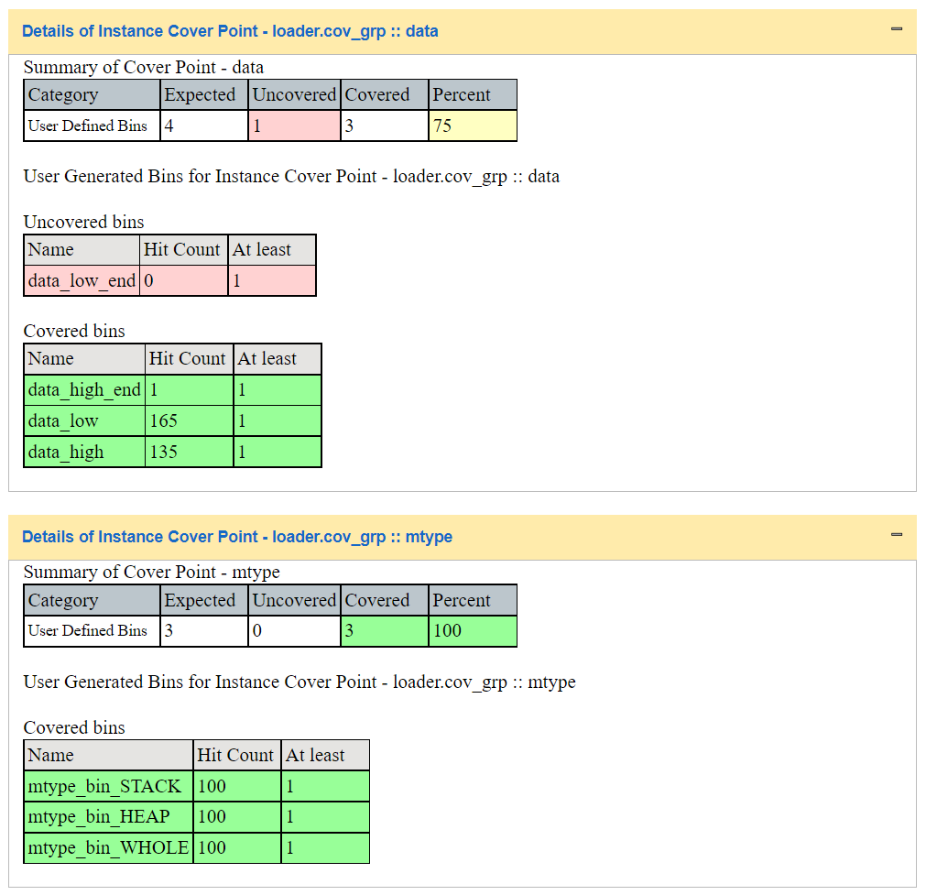
Example – Functional coverage
covergroup cov_grp;
coverpoint data {
bins data_low_end = {0};
bins data_high_end = {255};
bins data_low = {[0 : 127]};
bins data_high = {[128 : 255]};
}
coverpoint mtype {
bins mtype_bin [] = {[mtype.first : mtype.last]};
}
endgroup
None hits here
300 samples
repeat(100) begin
loader.randomize();
loader.cov_grp.sample();
mem.write(loader.addr, loader.data);
loader.display();
end
Evenly hits.
300 samples

Slide 36
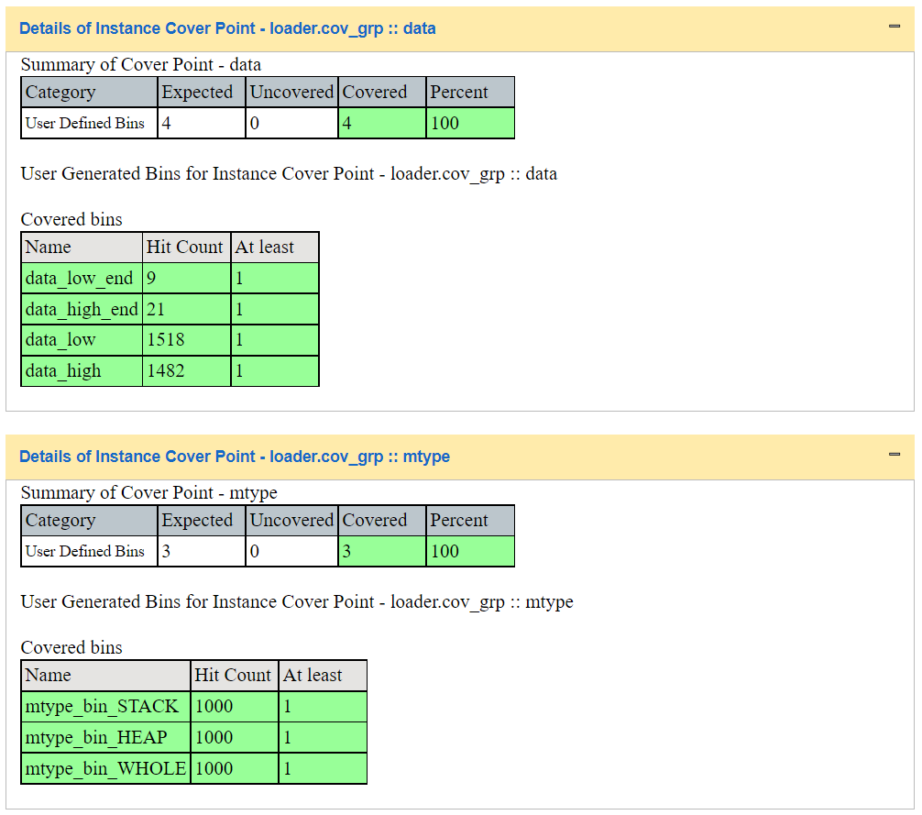
Example – Functional coverage
covergroup cov_grp;
coverpoint data {
bins data_low_end = {0};
bins data_high_end = {255};
bins data_low = {[0 : 127]};
bins data_high = {[128 : 255]};
}
coverpoint mtype {
bins mtype_bin [] = {[mtype.first : mtype.last]};
}
endgroup
All hits, but not evenly.
3000 samples
How to reach the conner cases faster?
repeat(1000) begin
loader.randomize();
loader.cov_grp.sample();
mem.write(loader.addr, loader.data);
loader.display();
end
Evenly hits.
3000 samples

Slide 37
Monitor FSM state transition using functional coverage
Functional coverage can be used to track variable transition, too.
This is helpful to monitor FSM state transition coverage.
FSM state transition covergroup added to the traffic light testbench (recall Verilog III).
The covergroup is automatically sampled on every clock rising edge.
Bins e.g. S_1_2 = (S_1 => S_2) is hit when traffic.cur_state changes from S_1 to S_2 on any clock rising edge.
Bins S_2_3_4 is hit when S_2 holds for 5000 cycles first, then S_3 for 30000 cycles, and then S_4 for 5000 cycles, across 40000 sequential clock posedges.
module tb;
reg car_sensor, clk, n_rst;
wire [2:0] light_1, light_2;
traffic DUT(car_sensor, clk, n_rst, light_1, light_2);
localparam
S_1 = 4'b0001,
S_2 = 4'b0010,
S_3 = 4'b0100,
S_4 = 4'b1000;
covergroup cov @ (posedge clk);
coverpoint traffic.cur_state {
bins S_1_2 = (S_1 => S_2);
bins S_2_3 = (S_2 => S_3);
bins S_3_4 = (S_3 => S_4);
bins S_4_1 = (S_4 => S_1);
bins S_2_3_4 = (S_2[*5000] => S_3[*30000] => S_4[*5000]);
bins S_4_3 = (S_4 => S_3);
}
endgroup
cov cov_fsm = new();
Covergroup cov automatically samples on clk posedge.
Monitor state transition sequence.
Don’t forget to instantiate the covergroup

Slide 38
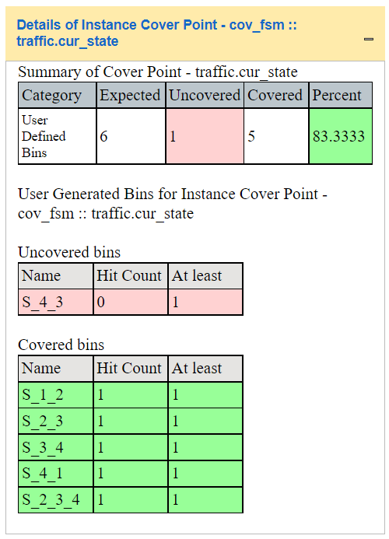
Monitor FSM state transition using functional coverage
module tb;
reg car_sensor, clk, n_rst;
wire [2:0] light_1, light_2;
traffic DUT(car_sensor, clk, n_rst, light_1, light_2);
localparam
S_1 = 4'b0001,
S_2 = 4'b0010,
S_3 = 4'b0100,
S_4 = 4'b1000;
covergroup cov @ (posedge clk);
coverpoint traffic.cur_state {
bins S_1_2 = (S_1 => S_2);
bins S_2_3 = (S_2 => S_3);
bins S_3_4 = (S_3 => S_4);
bins S_4_1 = (S_4 => S_1);
bins S_2_3_4 = (S_2[*5000] => S_3[*30000] => S_4[*5000]);
bins S_4_3 = (S_4 => S_3);
}
endgroup
cov cov_fsm = new();
We can never reach this state transition. That’s why it is never hit.
In the current TB we only has exercised each state transition once, thus the hit count for each bin is 1.

Slide 39

Questions?

